Slide 1
Escape
By: Michael Rallo
Video Demo: https://www.youtube.com/watch?v=5maeDKM86HI
Github: https://github.com/MichaelRallo/EscapeGame

Slide 2
Contact and Project Plan
Team Member List: Michael Rallo
Contact Person: Michael Rallo (msr5zb@mail.missouri.edu)
Title: Escape
Overview: Escape is a first person dungeon puzzle such that the user must navigate their way out of a dungeon in order to find a way to escape. There are obstacles and small puzzles that the player must overcome. Collision, object interaction, lighting, and more is demonstrated in this project.

Slide 3
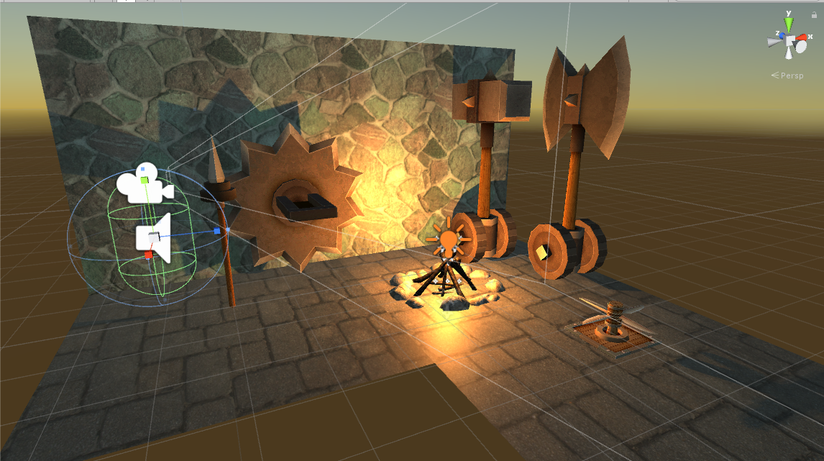
Assets
Assets used in this project were obtained from the Unity Asset Store: https://www.assetstore.unity3d.com/en/.

Slide 4
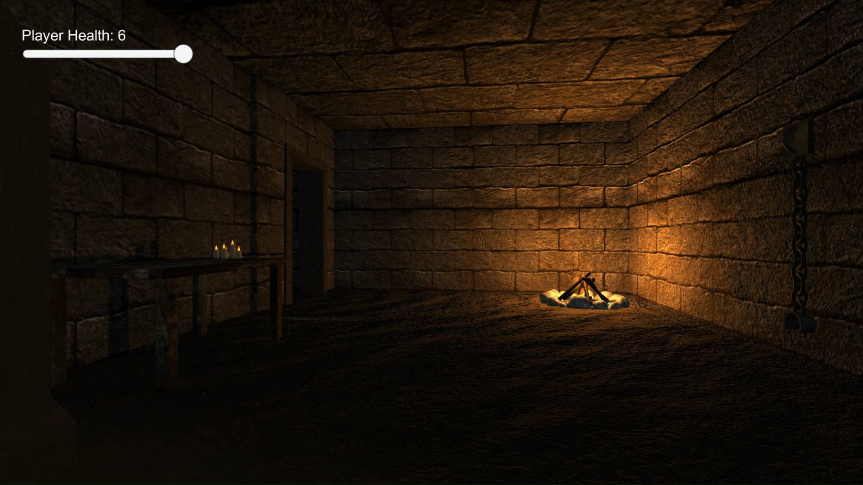
UI and Starting Room

Slide 5
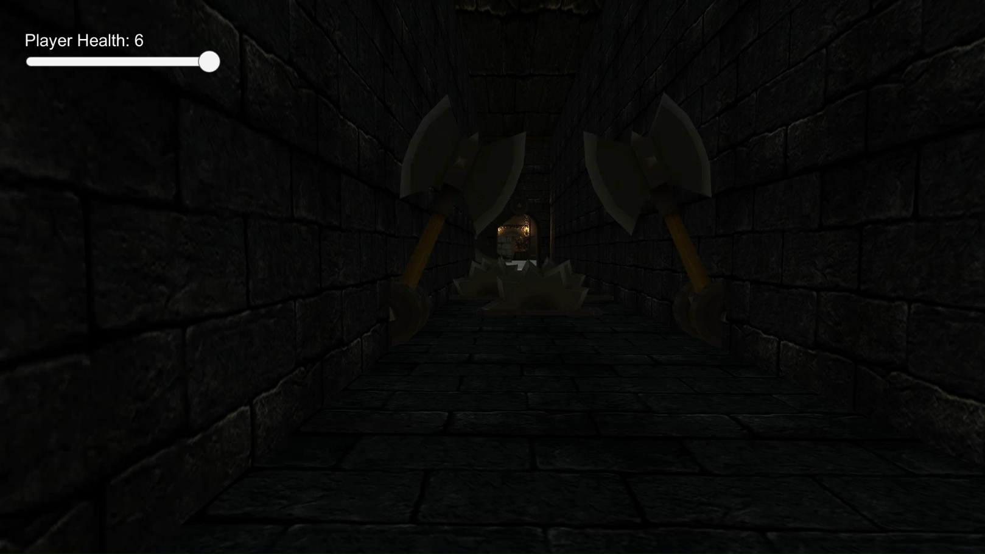
Hallway

Slide 6
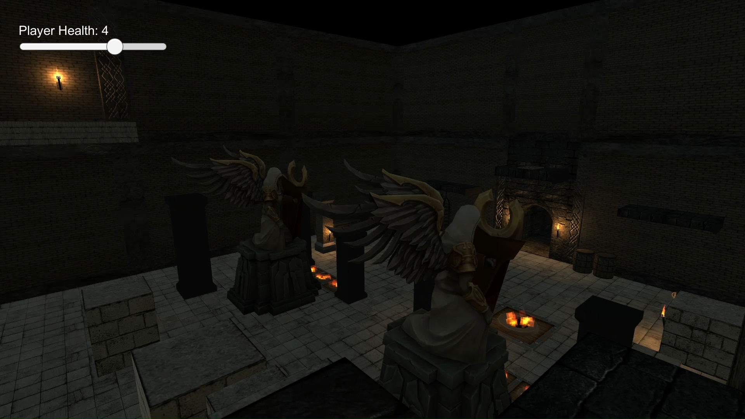
Obstacle Room

Slide 7
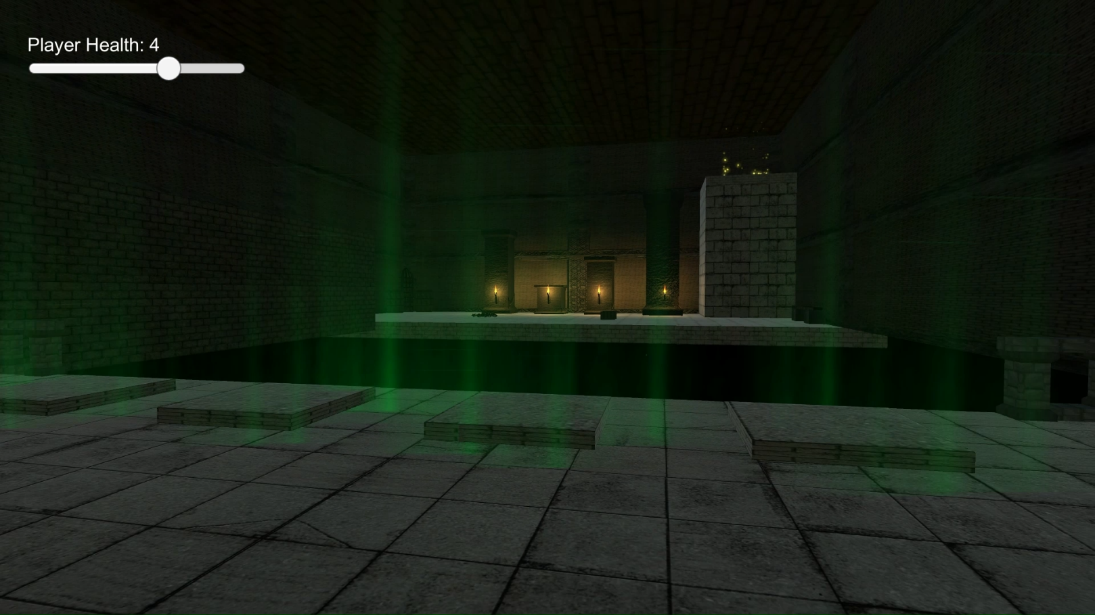
Puzzle Room

Slide 8
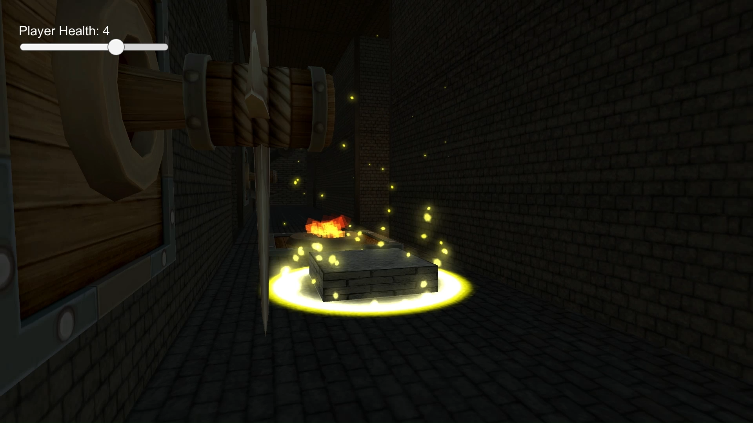
Maze

Slide 9
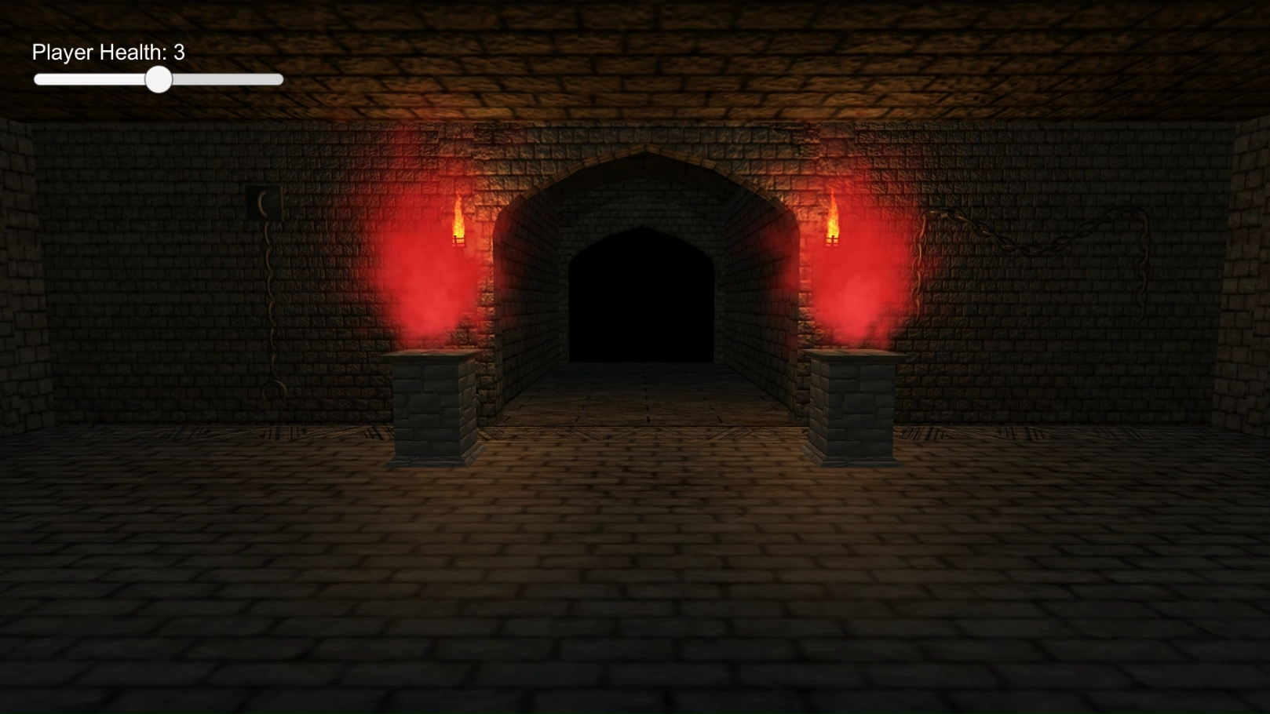
The End

